Slide 1




Prediction of flight delays with error calculation
Using machine learned classifiers

Slide 2
Agenda
Introduction
motivation
Results
Abstract
Literature survey
Modules
Algorithms used
References

Slide 3

Introduction
The causes of flight delays have been the focus of extensive study in recent years. Flight delays have risen as a result of the rising popularity of air travel.
There were over 860,00 arrival delays in 2016, according to BTS, and the FAA estimates that the sector loses over $3 billion annually due to airline delays.
Commercial scheduled flights are often late due to factors such as increased air traffic, an ever-increasing number of passengers, faulty equipment, bad weather, and a delay in the arrival of the plane that will be used for the next trip.
For domestic flights in the United States, the Federal Aviation Administration considers any time difference of more than 15 minutes between the planned and actual arrival times to be a delay.
The study and forecasting of aircraft delays are being explored to lessen costly disruptions as the issue grows in importance in the United States.

Slide 4


Airport capacity is often measured by average aircraft delay. Flight delays are commonplace. Explaining delays is difficult. Runway work and traffic are infrequent causes of aircraft delays, while severe weather is widespread. Reactionary delays from late arrivals delay some flights. Airports, airlines, and companies' marketing efforts suffer because frequent flyer programmed depend on client loyalty.
Motivation

Slide 5
Abstract
The industry-wide issue of flight delays is a serious one.
The expansion of the aviation industry over the past two decades has led to increased air traffic and consequent flight delays.
There is a cost to the environment as well as the economy when flights are delayed.
Commercial airlines also lose a lot of money due to flight delays. Consequently, they take all the precautions necessary to ensure that flight delays and cancellations are minimized or eliminated completely.
In this study, we use a variety of machine learning models to foretell whether a certain flight would arrive late. These models include Logistic Regression, Decision Tree Regression, Bayesian Ridge, Random Forest Regression, and Gradient Boosting Regression.

Slide 6
Literature survey
The industry-wide issue of flight delays is a serious one.
The expansion of the aviation industry over the past two decades has led to increased air traffic and consequent flight delays.
There is a cost to the environment as well as the economy when flights are delayed.
In this study, we use a variety of machine learning models to foretell whether a certain flight would arrive late.
These models include Logistic Regression, Decision Tree Regression, Bayesian Ridge, Random Forest Regression, and Gradient Boosting Regression.

Slide 7
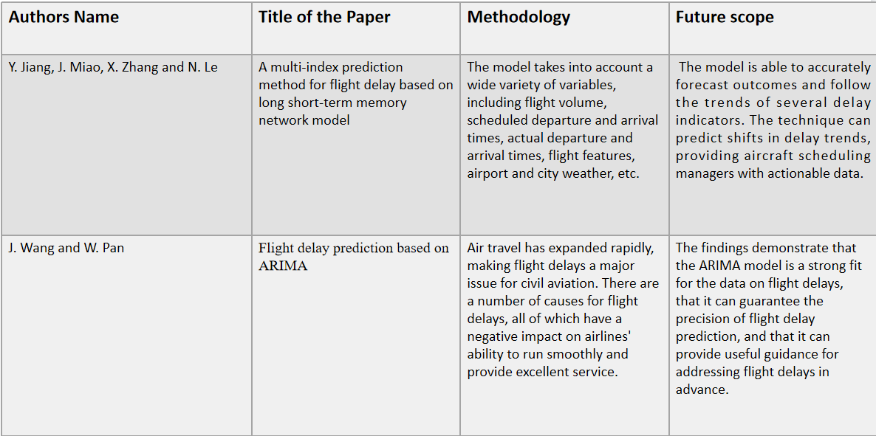

Slide 8
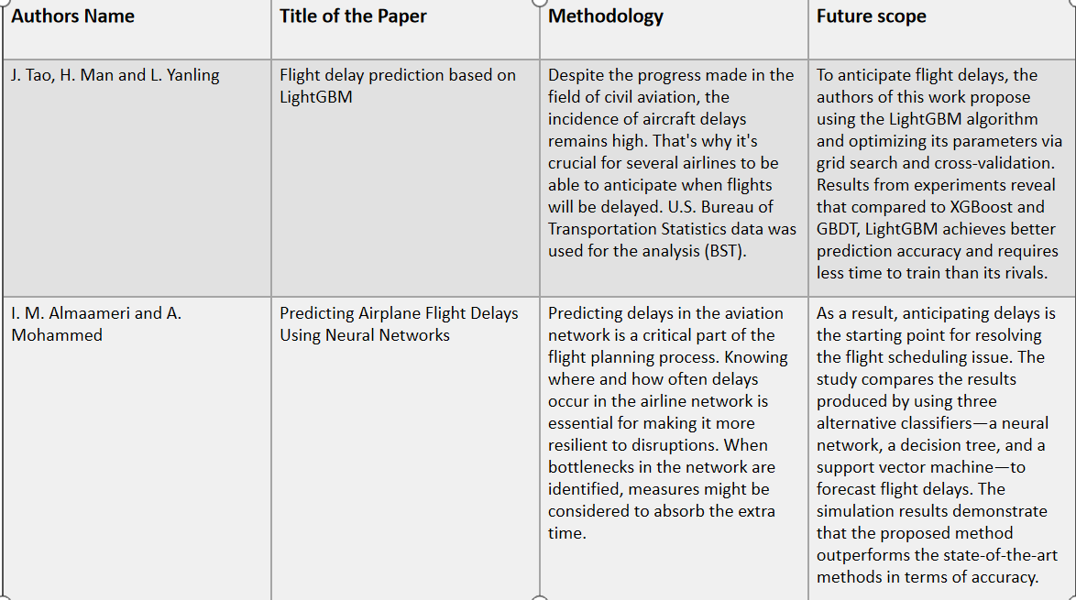

Slide 9
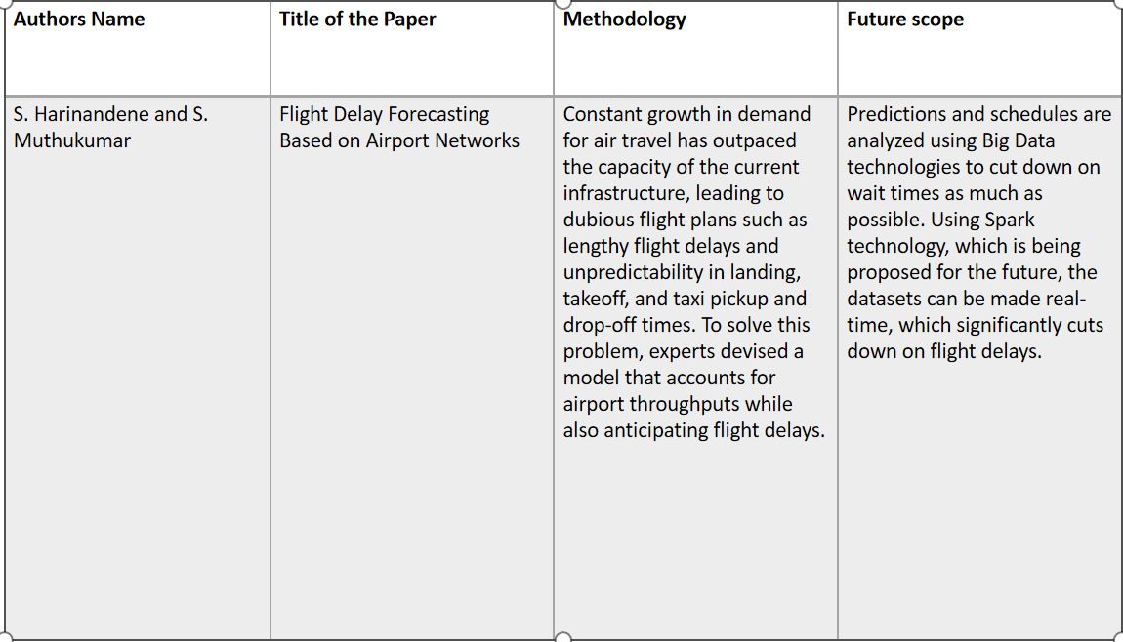

Slide 10
Inferences from literature survey
From the above-mentioned literature works, it is clear that there has been effective research on this topic has been done and many models have been proposed.
It is evident that the above-mentioned systems have their own pros and cons.
While some of the recent works involve hybrid technologies and provide better accuracies, they are still far from what is needed.
With higher accuracy, comes the need for low computational costs, high processing speed, and most of all, the convenience of use.

Slide 11
The objective of the predictive model is to build a model to predict whether a flight will bedelayed or not based on certain characteristics of the flight. Such a model may help both passengers as well as airline companies to predict future delays and minimize them. We strive to forecast whether a flight will be delayed in a variety of ways by utilizing Machine Learning (ML).
Objectives

Slide 12

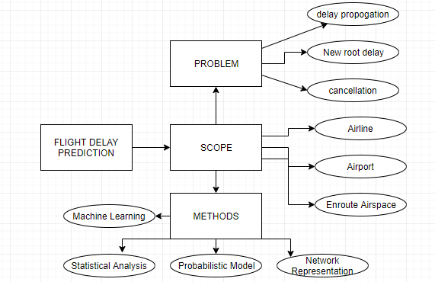
System Architecture

Slide 13
Modules
Module 1: Collecting and preprocessing data
Module 2: Feature extraction
Module 3: Training the model

Slide 14

Module 1: Collecting and preprocessing data
We used data collected by the U.S. Department of Transportation's Bureau of Transportation Statistics on all domestic flights taken in 2015 to train models for predicting flight delays. There are 25 columns and 59986 rows total in the dataset.
A large number of lines had blank or null values. It is necessary to preprocess the data before using it.
Since real-world data is often unreliable due to its incompleteness, noise, and inconsistency, it is necessary to perform data preprocessing before conducting any analysis.
There are 25 columns and 59986 rows total in the dataset.
Numerous rows had blank or empty cells. In order to clean up the data set, the null values were removed using the dropna() function in pandas.
The number of rows was cut down to 54486 after some preprocessing.

Slide 15
Module 2 : Feature extraction
Feature extraction is a process of dimensionality reduction by which an initial set of raw data is reduced to more manageable groups for processing,A characteristic of these large data sets is a large number of variables that require a lot of computing resources to process.
Feature extraction is the name for methods that select and /or combine variables into features, effectively reducing the amount of data that must be processed, while still accurately and completely describing the original data set.
The process of feature extraction is useful when you need to reduce the number of resources needed for processing without losing important or relevant information.

Slide 16
Module 3 : Training the model
Model training is the primary step in machine learning, resulting in a working model that can then be validated, tested and deployed. The model’s performance during training will eventually determine how well it will work when it is eventually put into an application for the end-users.
Both the quality of the training data and the choice of the algorithm are central to the model training phase. In most cases, training data is split into two sets for training and then validation and testing.
The selection of the algorithm is primarily determined by the end-use case. However, there are always additional factors that need to be considered, such as algorithm-model complexity, performance, interpretability, computer resource requirements, and speed. Balancing out these various requirements can make selecting algorithms an involved and complicated process.

Slide 17
Description of software for implementation
Hardware specifications:
Microsoft Server enabled computers, preferably workstations
Higher RAM, of about 4GB or above Processor of frequency
1.5GHz or above
Software specifications:
Python 3.6 and higher Anaconda software

Slide 18
Algorithms used:
Decision tree
Random forest
Gradient boosting
Logistic regression
Bayesian regression

Slide 19
Decision Tree: As the name suggest the main idea behind decision tree algorithm is to make a tree like structure and get the answers in form of true or false. The model begins from a root node and ends on the decision. Each node receives a Yes or No question and answer is passed on to the next node. Root node gets all the input of the training dataset. Random Forest : Random Forest algorithm is an ensemble learning algorithm which uses Bagging. The Random Forest Classifier creates a number of Decision Trees.Random forest is a commonly-used machine learning algorithm trademarked by Leo Breiman and Adele Cutler, which combines the output of multiple decision trees to reach a single result. Its ease of use and flexibility have fueled its adoption, as it handles both classification and regression problems.Random forest algorithms have three main hyperparameters, which need to be set before training. hese include node size, the number of trees, and the number of features sampled. From there, the random forest classifier can be used to solve for regression or classification problems.

Slide 20
Logistic regression: This type of statistical model (also known as logit model) is often used for classification and predictive analytics. Logistic regression estimates the probability of an event occurring, such as voted or didn’t vote, based on a given dataset of independent variables. Since the outcome is a probability, the dependent variable is bounded between 0 and 1. In logistic regression, a logit transformation is applied on the odds—that is, the probability of success divided by the probability of failure. This is also commonly known as the log odds, or the natural logarithm of odds. Bayesian regression: Bayesian linear regression is a type of conditional modeling in which the mean of one variable is described by a linear combination of other variables, with the goal of obtaining the posterior probability of the regression coefficients (as well as other parameters describing the distribution of the regressand) and ultimately allowing the out-of-sample prediction of the regressand (often labelled y) conditional on observed values of the regressors (usually X). The simplest and most widely used version of this model is the normal linear model, in which y given X is distributed Gaussian. In this model, and under a particular choice of prior probabilities for the parameters—so-called conjugate priors—the posterior can be found analytically. With more arbitrarily chosen priors, the posteriors generally have to be approximated.

Slide 21
Gradient boosting: The idea of gradient boosting originated in the observation by Leo Breiman that boosting can be interpreted as an optimization algorithm on a suitable cost function. Explicit regression gradient boosting algorithms were subsequently developed, by Jerome H. Friedman simultaneously with the more general functional gradient boosting perspective of Llew Mason, Jonathan Baxter, Peter Bartlett and Marcus Frean.The latter two papers introduced the view of boosting algorithms as iterative functional gradient descent algorithms. That is, algorithms that optimize a cost function over function space by iteratively choosing a function (weak hypothesis) that points in the negative gradient direction. This functional gradient view of boosting has led to the development of boosting algorithms in many areas of machine learning and statistics beyond regression and classification.

Slide 22
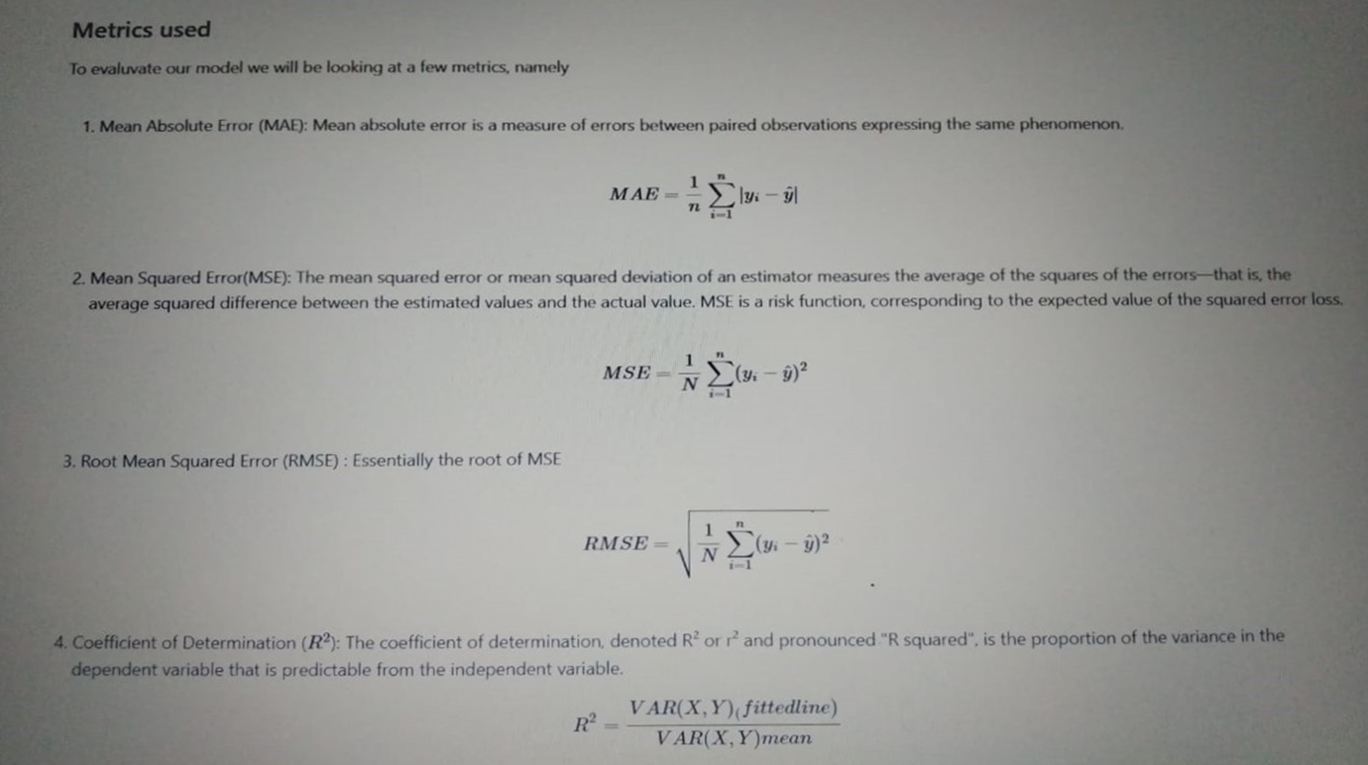
Error calculation :

Slide 23
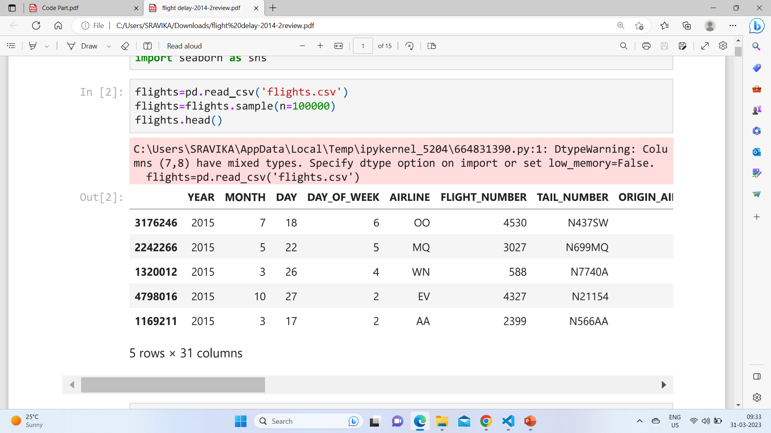
Datasets before cleaning:

Slide 24
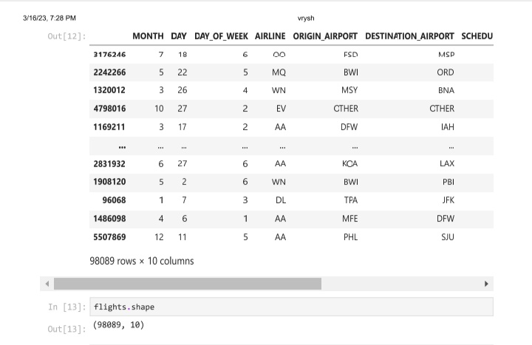
Dataset after cleaning:

Slide 25
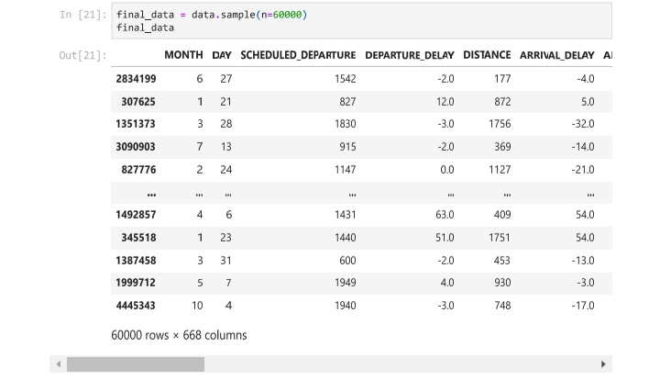
Dataset after cleaning:

Slide 26
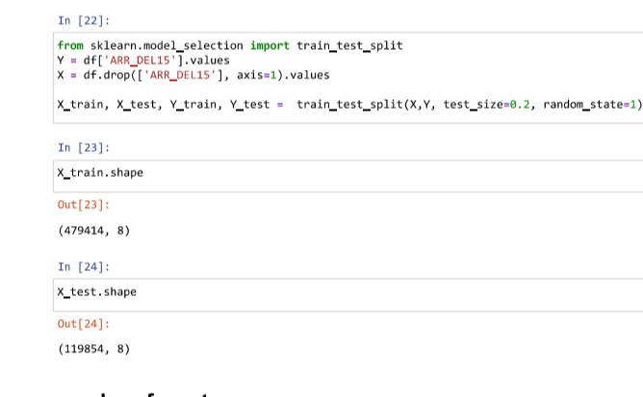
Training and testing:

Slide 27
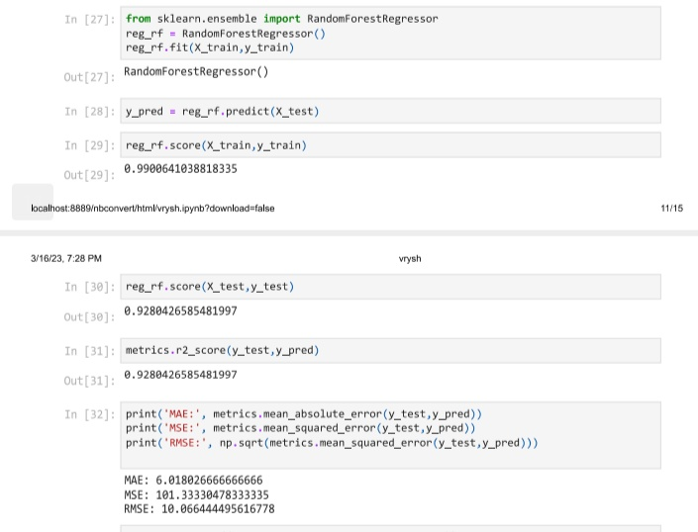
error calculation for random forest:

Slide 28
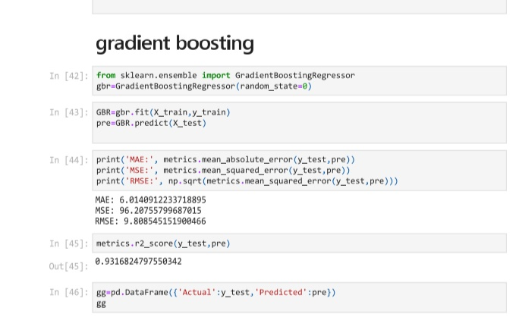
error calculation for Gradient Boosting:

Slide 29
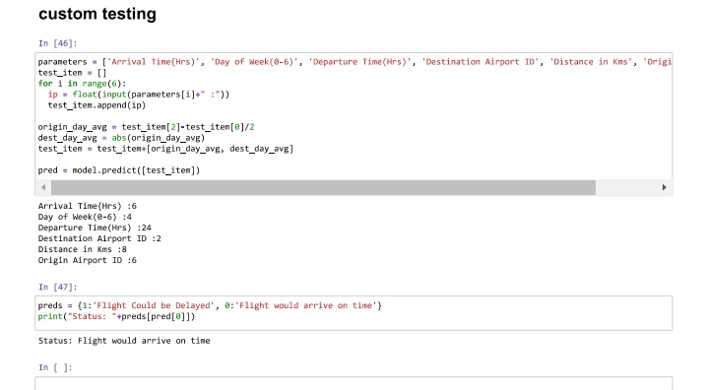
prediction

Slide 30
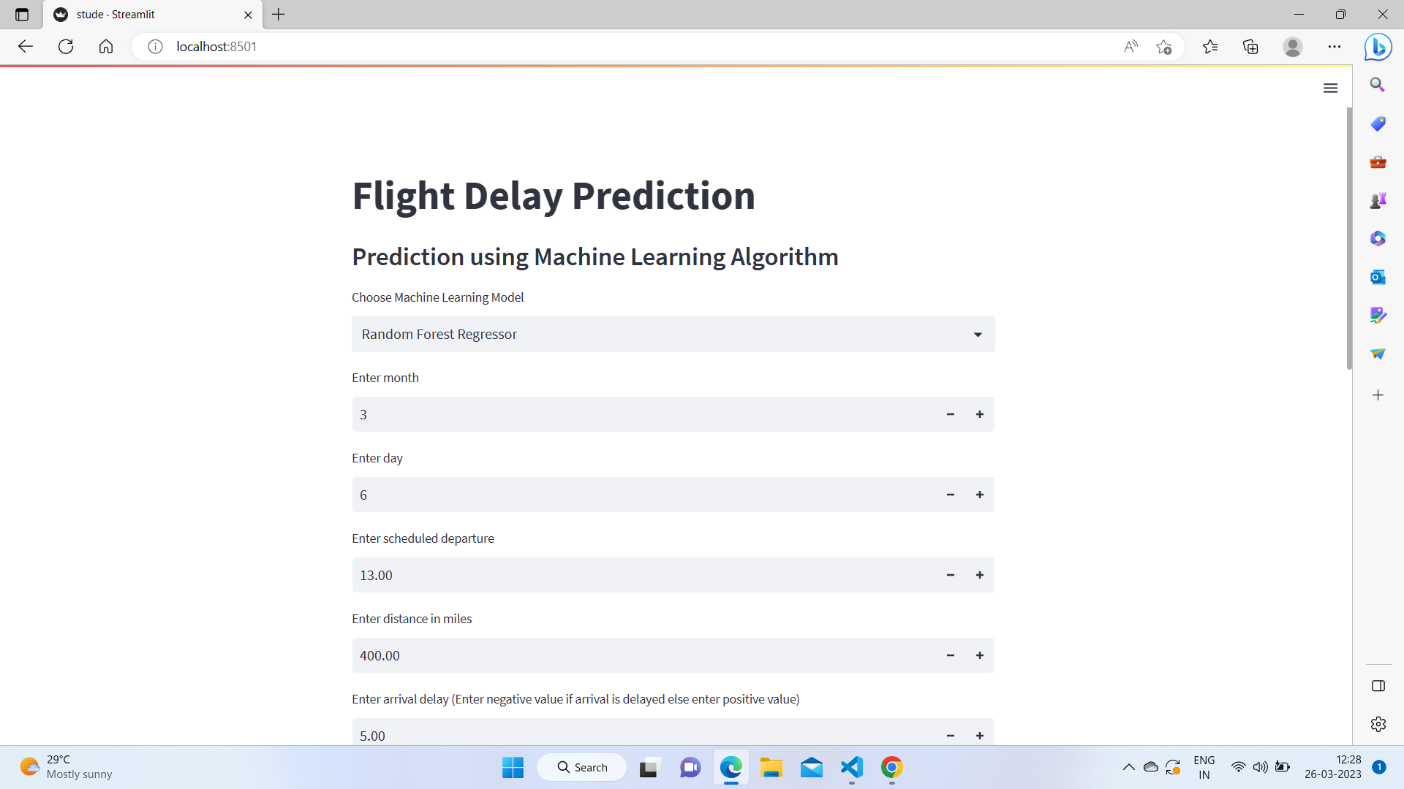
website:

Slide 31
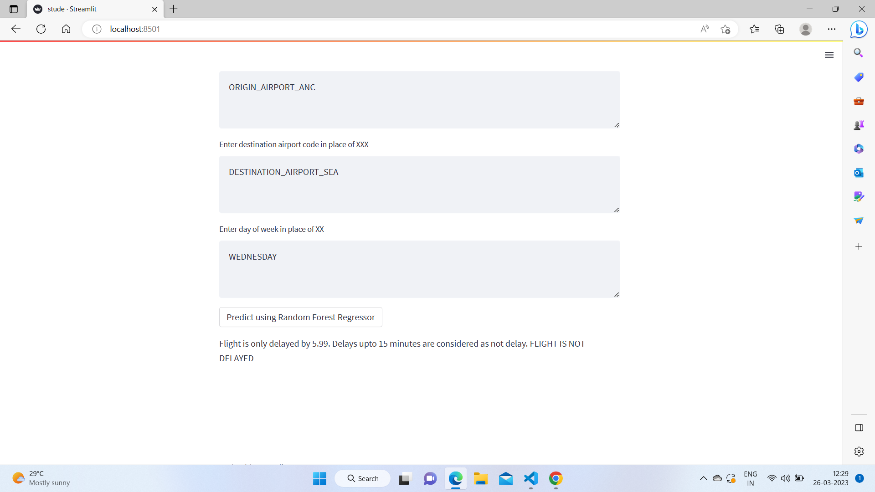

Slide 32
THANK YOU
TEAM MEMBERS:
321910302013-M.DHAMU
321910302014-N.SRAVIKA
321910302022-K.SRAVANI
321910302034-P.MAHESWARI
321910302039-V.MAVYA
GUIDE:
JAGANNATHA REDDY SIR

